Slide 1
Spider web simulation
Changrui Cai & Jiahua He

Slide 2
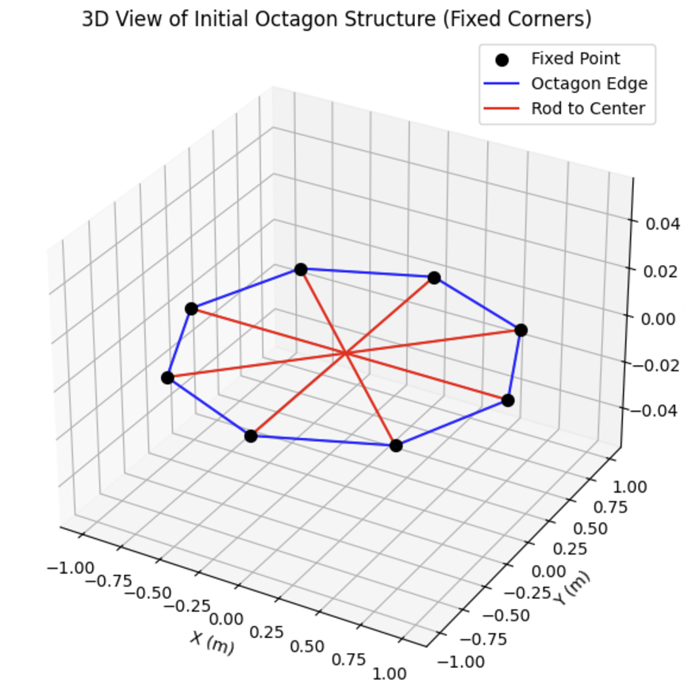
Assumption
Create an octagonal mesh, with each line pointing toward the center as an independent rod. Due to symmetry, assume that all edges of the octagon are fixed.
Apply a constant force at the center of the octagon. Use the Newton-Raphson scheme method to solve for the displacement.
F

Slide 3
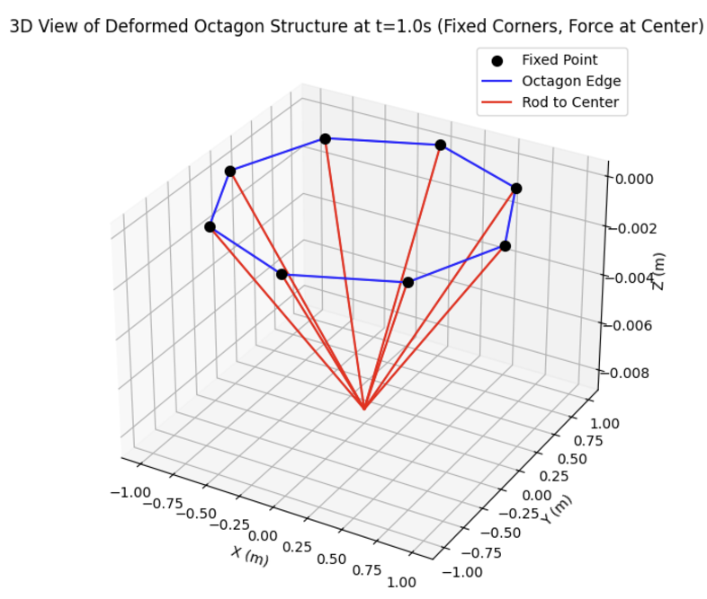
t = 0.0s
t = 2.0s

Slide 4
Future Plan
The current force is a constant force, which does not match the reality. The force will be adjusted to one that gradually decreases with acceleration, reflecting realistic conditions.
Break the rods pointing from the corners to the center into more sections to approximate realistic results as closely as possible.
Using gradient and hessian of elastic energies to improve accuracy.

Slide 5
Thank you

